Slide 1
Topic 15 Reversible Work
Thermodynamics: An Engineering Approach
8th Edition Yunus A. Çengel, Michael A. Boles
McGraw-Hill, 2015

Slide 2
Objectives
Examine a special class of idealized processes, called isentropic processes, and develop the property relations for these processes.
Derive the reversible steady-flow work relations.
Develop the isentropic efficiencies for various steady-flow devices.
Apply the second law of thermodynamics to processes.

Slide 3
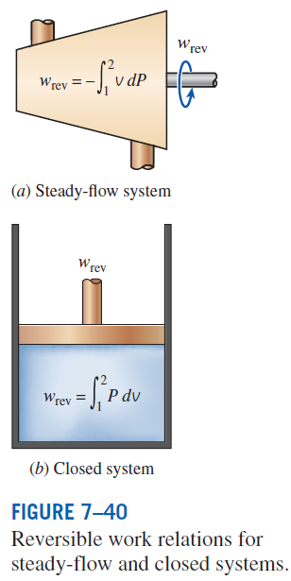

REVERSIBLE STEADY-FLOW WORK
Recall the formula for boundary work:
This was useful for closed systems like piston cylinders. But what about open, steady flow systems like turbines?
Total Energy Balance (differential form):

Slide 4


Reversible Steady-flow Work
If kinetic and potential energies are ignored, then:

Slide 5



Reversible Steady-flow Work
Look familiar?
What if there is no work?
Bernoulli Equation

Slide 6
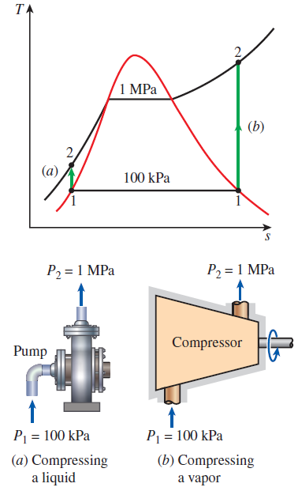
Compressing a Liquid vs. Gas
Example 1
Determine the work input required to compress steam isentropically from 100 kPa to 1 MPa, assuming that the steam exists as (a) saturated liquid and (b) as saturated vapor.

Slide 7
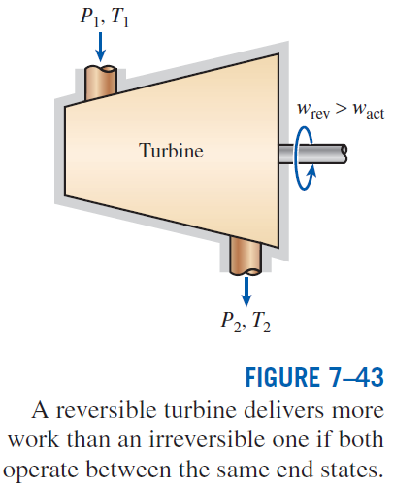

Proof that Reversible Process is more Efficient

Slide 8
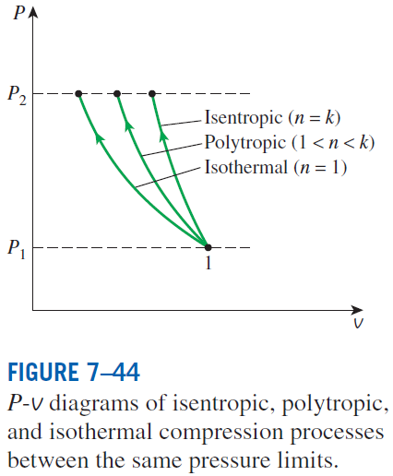
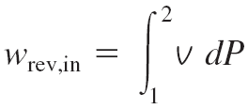
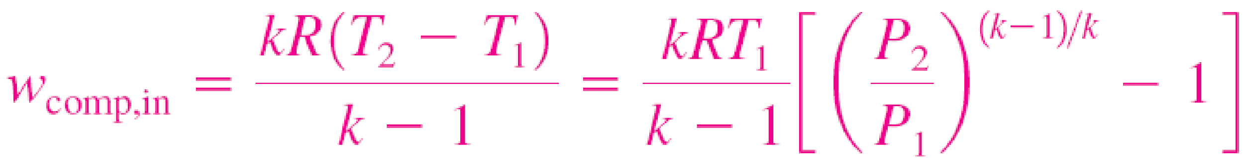
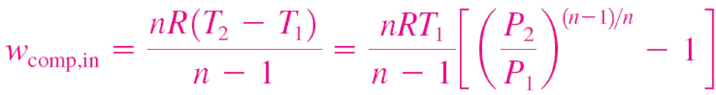
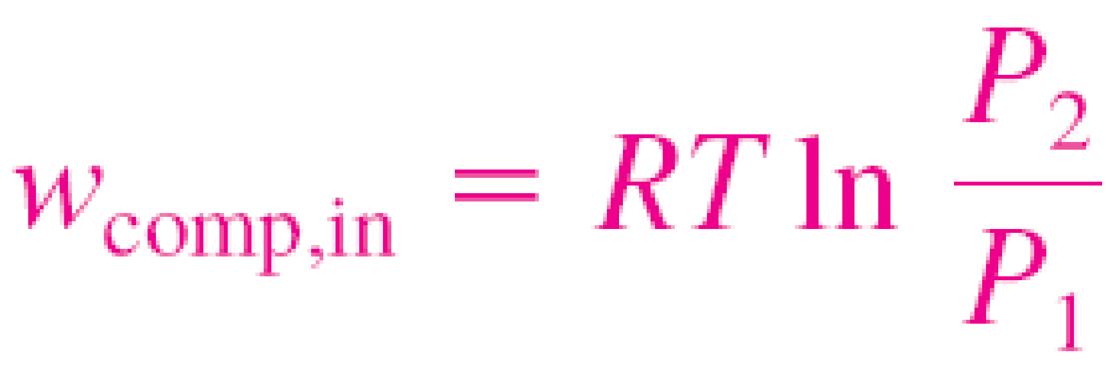
MINIMIZING THE COMPRESSOR WORK
When kinetic and potential energies are negligible
Isentropic (Pv^{k} = constant):
Polytropic (Pv^{n} = constant):
Isothermal (Pv = constant):
The adiabatic compression (Pv^{k} = constant) requires the maximum work and the isothermal compression (T = constant) requires the minimum. Why?
Notes:
Reducing work because v is low means gas must be cooled as much as possible.
Area to left of curve is work, so easy to see which is larger and smaller
Isothermal has max cooling therefore minimum work; adiabatic has no cooling therefore maximum work

Slide 9
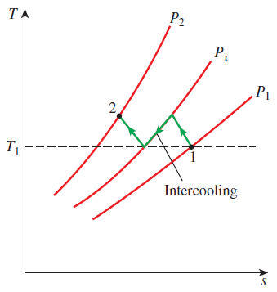
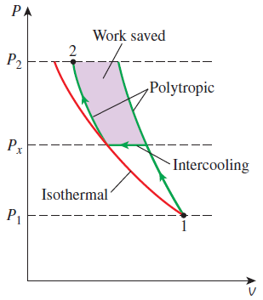

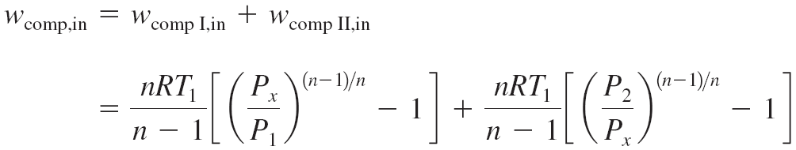
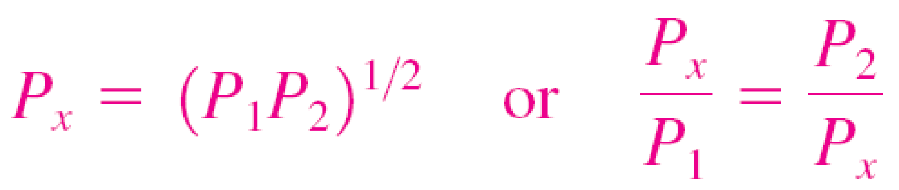
Multistage Compression with Intercooling
The gas is compressed in stages and cooled between each stage by passing it through a heat exchanger called an intercooler.
To minimize compression work during two-stage compression, the pressure ratio across each stage of the compressor must be the same.

Slide 10
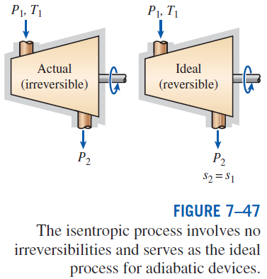
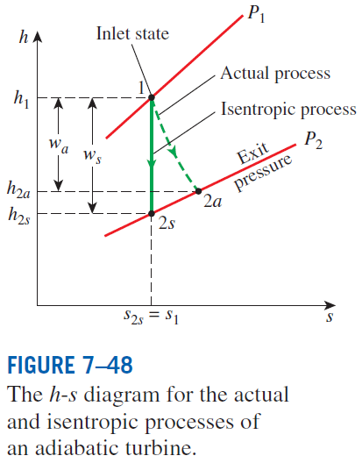

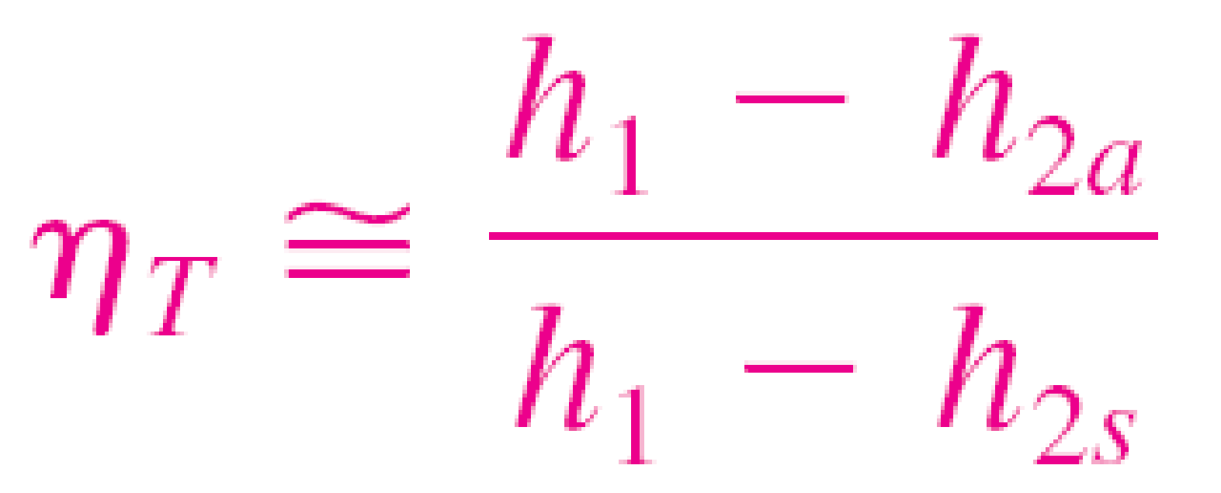
ISENTROPIC EFFICIENCIES OF STEADY-FLOW DEVICES
Isentropic Efficiency
of Turbines
Notes:
Analogous to Carnot cycle (ideal cycle) to let us compare actual efficiency or COP with ideal; isentropic efficiency lets us compare actual device to ideal one

Slide 11
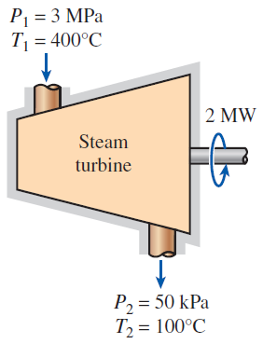
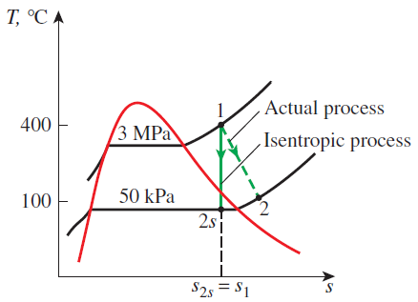
Isentropic Efficiency of a Turbine
Example 2
Steam enters an adiabatic turbine steadily at 3 MPa and 400ºC and leaves at 50 kPa and 100ºC. If the power output of the turbine is 2 MW, determine the isentropic efficiency and the mass flow rate of the steam.

Slide 12
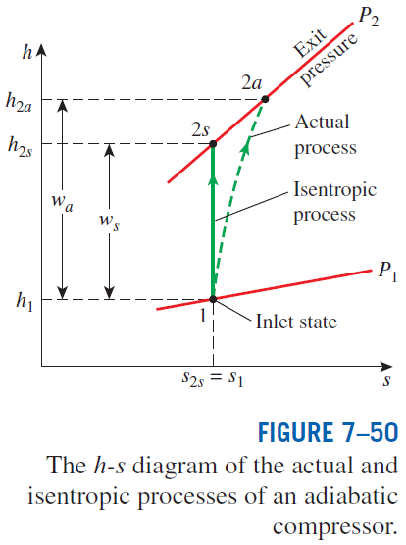
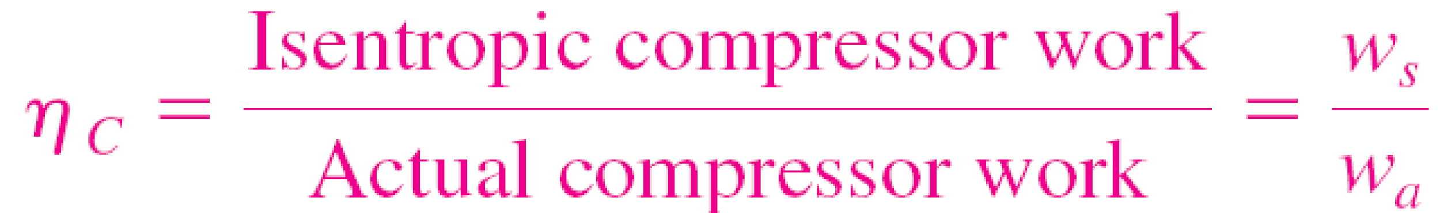
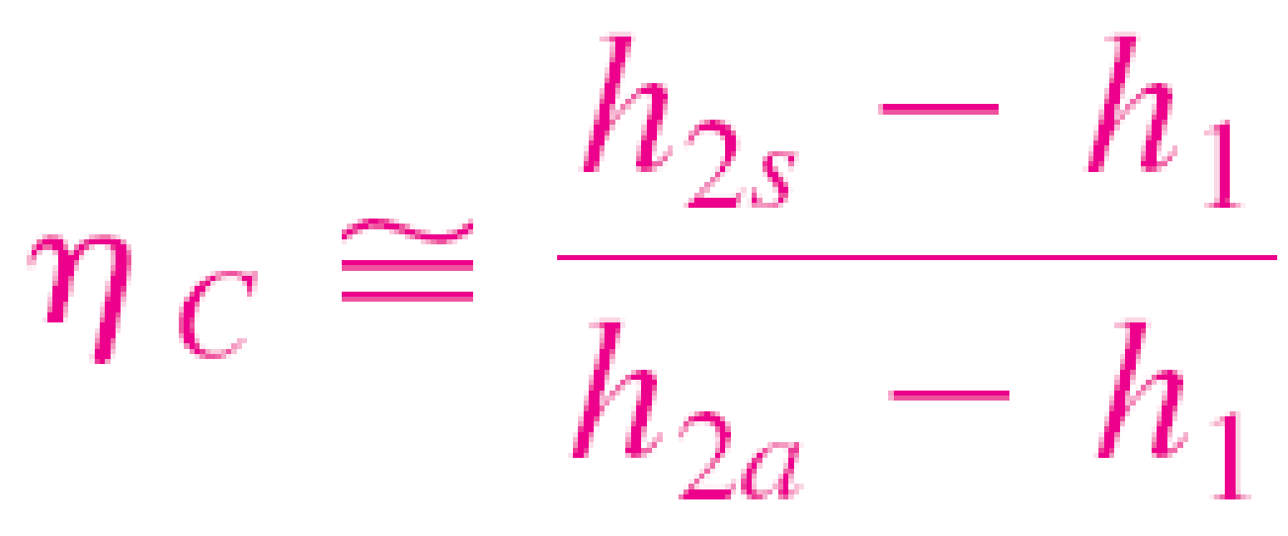
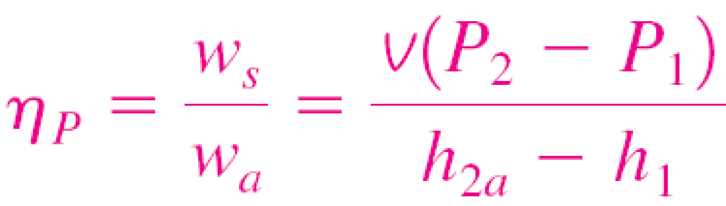

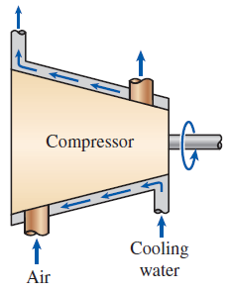
Isentropic Efficiencies of Compressors and Pumps
When kinetic and potential energies are negligible
For a pump
Isothermal efficiency
Compressors are sometimes intentionally cooled to minimize the work input.
Can you use isentropic efficiency for a non-adiabatic compressor?
Can you use isothermal efficiency for an adiabatic compressor?
Notes:
Notice ws in numerator, because isentropic work input < actual work input
No, can’t use isentropic eff. If compressor is cooled to reduce work because now it is non-adiabatic.
Yes, can use isothermal eff. Equation if compressor is adiabatic

Slide 13
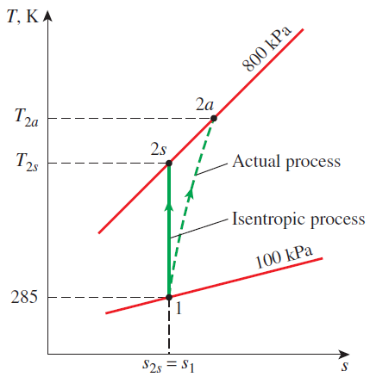
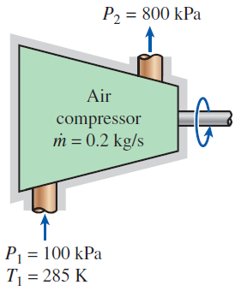
Effect of Efficiency on Compressor Power Input
Example 3
Air is compressed by an adiabatic compressor from 100 kPa and 12ºC to a pressure of 800 kPa at a steady rate of 0.2 kg/s. If the isentropic efficiency is 80%, determine the air temperature at the exit and the require power input for the compressor.

Slide 14
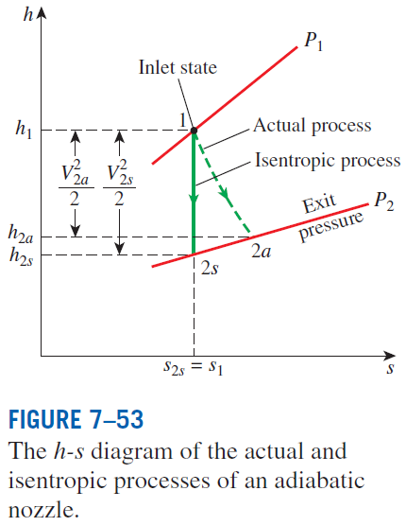
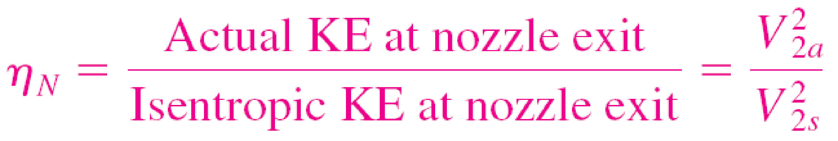
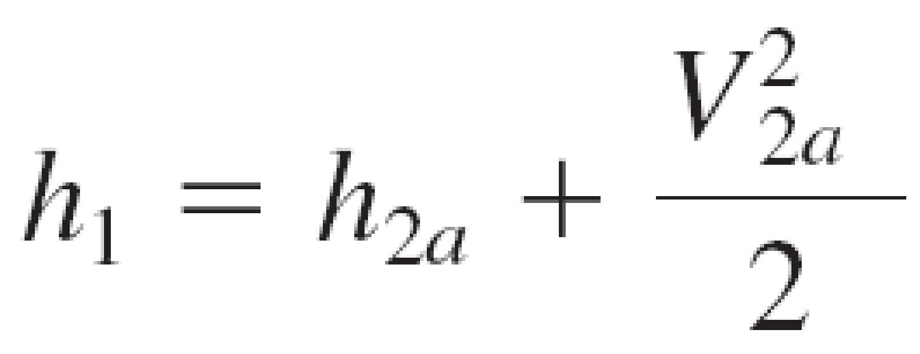
Isentropic Efficiency of Nozzles
If the inlet velocity of the fluid is small relative to the exit velocity, the energy balance is
Then,
Notes:
Note exit pressure is the same, but exit state is different (less subcooled or more superheated)

Slide 15
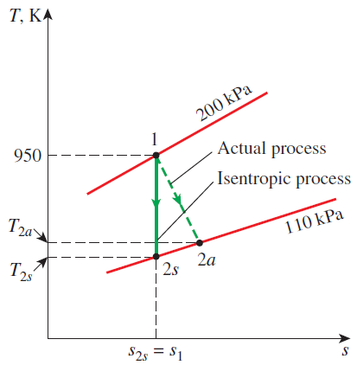
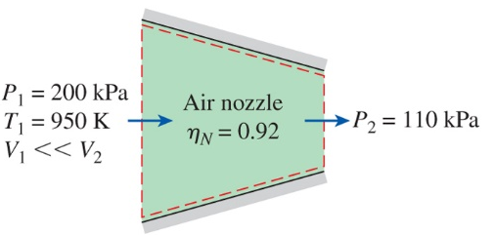
Effect of Efficiency on Nozzle Exit Velocity
Example 4
Air at 200 kPa and 950 K enters an adiabatic nozzle at low velocity and is discharged at a pressure of 110 kPa. If the isentropic efficiency of the nozzle is 92%, determine the maximum possible velocity, the exit temperature of the air, and the actual velocity of the air. Assume constant specific heat of air is 1.11 kJ/ kg K and the specific heat ratio is 1.349.

Slide 16
Summary
Reversible steady-flow work
Minimizing the compressor work
Isentropic efficiencies of steady-flow devices
The increase of entropy principle

